Slide 1




PSYCHOLOGY NEWSLETTER
Here is where your presentation begins

Slide 2


CONTENTS OF THIS TEMPLATE
You can delete this slide when you’re done editing the presentation
Fonts | To view this template correctly in PowerPoint, download and install the fonts we used
Used and alternative resources | An assortment of graphic resources that are suitable for use in this presentation
Thanks slide | You must keep it so that proper credits for our design are given
Colors | All the colors used in this presentation
Icons and infographic resources | These can be used in the template, and their size and color can be edited
Editable presentation theme | You can edit the master slides easily. For more info, click here
For more info:
SLIDESGO | BLOG | FAQs
You can visit our sister projects:
FREEPIK | FLATICON | STORYSET | WEPIK | VIDEVO

Slide 3


TABLE OF CONTENTS
01
02
03
04
05
06
HEADLINE NEWS
IN DEPTH ANALYSIS
BEHIND THE SCENES
TIPS & TRICKS
UPCOMING EVENTS
COMMUNITY CORNER

Slide 4



HEADLINE NEWS
01

Slide 5

HEADLINE NEWS
Exciting news! Our company has just released a cutting-edge product that is poised to revolutionize the industry. With this new technology, businesses can:
Optimize their workflow and increase productivity
Automate routine tasks and free up any possible valuable resources
Improve their bottom line by reducing costs and boosting profits
Stay tuned for more updates on this exciting development as we continue to innovate and push the boundaries of what's possible!

Slide 6

IN DEPTH ANALYSIS
EMERGING TECHNOLOGIES
Analyze a new and emerging technology that is disrupting or transforming your industry. Discuss its potential impact on businesses and consumers, and provide insights into how companies can adapt to these new changes
MARKET TRENDS
Provide an in-depth analysis of recent market trends that are affecting your industry. This could include examining changes in consumer behavior, shifts in supply and demand, or emerging market opportunities. Offer insights into how businesses can capitalize on these trends to stay competitive

Slide 7

BEHIND THE SCENES
PRODUCTION PROCESS
COMPANY CULTURE
CUSTOMER SERVICE
We pride ourselves on our high-quality products that are made with care from start to finish. Our team sources the best materials and uses skilled craftsmanship to transform raw materials into beautiful finished products
Our company culture is built on collaboration, innovation, and open communication. We prioritize work-life balance by offering flexible schedules and remote work options when possible
Our customer service team is dedicated to providing exceptional support. We believe in building long-term relationships with our customers based on trust, transparency, and excellent service

Slide 8

TIPS & TRICKS
TIME MGMT.
NETWORKING
COMMUNICATION
Break your day into smaller chunks and focus on one task at a time. Take short breaks in between to stay fresh
Attend events, join professional organizations, and connect with others in your field on social media to expand your network
Be concise when communicating ideas, actively listen to feedback, and be open to constructive criticism
SELF-CARE
LEARNING
GOAL-SETTING
Make time for exercise, healthy eating, and hobbies outside of work to reduce stress and promote relaxation
Attend workshops or conferences, read industry publications, and take online courses to expand your knowledge base
Set clear goals by breaking them down into smaller achievable steps and by celebrating progress

Slide 9

MORE NEWS!
NEW PRODUCT LAUNCH
COMPANY EXPANSION
Our company is excited to announce the launch of a new product line that has been in development for months. This innovative product is expected to revolutionize our industry
We have recently expanded our operations by opening a new office in a different place. This expansion will allow us to better serve our customers and grow our business
AWARD RECOGNITION
CSR
Our company has been recognized for excellence in our industry by receiving an award. This recognition reflects the hard work and dedication of all of our amazing employees
We have recently partnered with a nonprofit organization to provide support and resources to those in need. We believe it is important to be socially responsible

Slide 10
—COMPANY’S QUOTE
"Believe in yourself and all that you are. Know that there is something inside you that is greater than any obstacle"

Slide 11
APRIL 14
JUNE 6
JULY 12
Virtual conference on the future of technology
Product demo day for new features and updates
Networking event with industry leaders

Slide 12
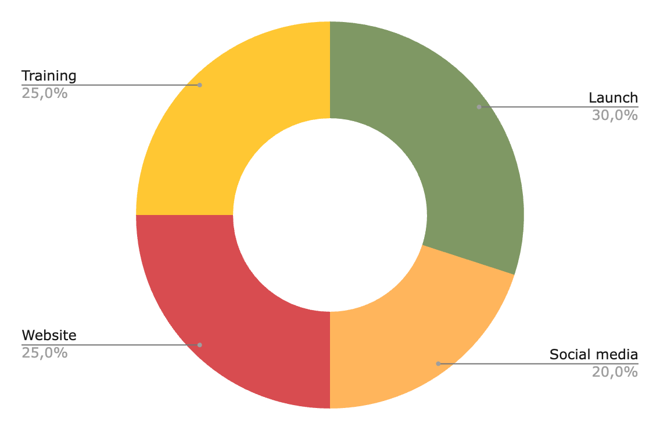
PLANS FOR NEXT QUARTER
LAUNCH
SOCIAL MEDIA
WEBSITE
TRAINING
Follow the link in the graph to modify its data and then paste the new one here. For more info, click here

Slide 13
ARE OUR PRODUCTS WORKING?
PRODUCT | PRICE | DISCOUNT | AVAILABILITY | COMMENTS | RATING
Product 1 | $20 | 10% off | In stock | “Very good” | 4/5
Product 2 | $25 | No discount | Out of stock | “Could be better” | 1/5
Product 3 | $50 | 15% off | In stock | “Quite satisfied” | 3/5
Product 4 | $30 | No discount | In stock | “Useful” | 2/5
Product 5 | $40 | 20% off | In stock | “Amazing!” | 5/5
Product 6 | $15 | 5% off | In stock | “Practical” | 4/5

Slide 14
“EXCLUSIVE AND INSPIRING”

Slide 15
PROCESS FOR THE NEXT LAUNCH
Planning phase
Product development
Testing
Content creation
Pre-launch
Launch
Post-launch follow-up
Evaluation

Slide 16
ORGANIZATIONAL CHART
CEO
VP of sales
VP of operations
Nation Sales Manager
IT
Manager
Product Manager
Product Manager
Sales Coordinator
Sales Rep.
Designer
Designer
Designer

Slide 17
LIFE’S MOMENTS
Don't let life's special moments slip away - capture and preserve them through photographs. In this newsletter we want to show you these special moments!

Slide 18



TESTIMONIALS
“I was blown away by the exceptional customer service I received from this company”
—LAURA PATTERSON
“The quality of the products I received from this company exceeded my expectations by a lot”
—JOHN NELSON
"I love how easy it is to navigate this company's website and place an order. Everything is simple and easy”
—PETER JAMES

Slide 19
CASE STUDIES
CAMPAIGN OBJECTIVES
RESULTS
Increase brand awareness and drive sales for a new line of eco-friendly products
23%
80%
+10%
Increase in website traffic
Increase
in sales
Increase
in clicks
APPROACH
A social media campaign that focused on showcasing the sustainability and quality of our products
Collaboration with influencers
Encourage their followers to make more environmentally conscious choices
KEY TAKEAWAY 1
Partnering with influencers who align with the same brand values
KEY TAKEAWAY 2
Highlighting the unique qualities of your product, such as sustainability

Slide 20
THANKS!
DOES ANYONE HAVE
ANY QUESTIONS?
addyouremail@freepik.com
+91 620 421 838
yourwebsite.com
Please keep this slide for attribution

